Slide 1

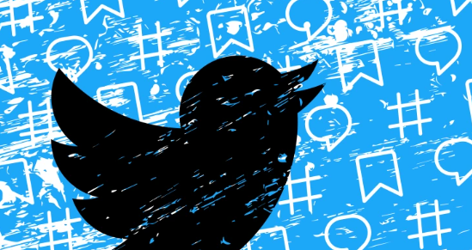

Game ON!: Twitter sentiment analysis on Posts About Video Games
Presented by:
Jake conard

Slide 2

Overview
Twitter is a microblogging and social networking service owned by American company Twitter, Inc., on which users post and interact with messages known as "tweets". Registered users can post, like, and retweet tweets, while unregistered users only have a limited ability to read public tweets.
Research is focused on using a data revolving around “Tweets” about popular computer and console games.
Dataset is taken from Kaggle at the below link:
https://www.kaggle.com/datasets/jp797498e/twitter-entity-sentiment-analysis

Slide 3



Video Game Examples

Slide 4
About the Data
One column is the sentiment of the tweet and the other column is the content of the tweet.
There are two possible sentiments for the tweet, either ‘positive’ or ‘negative’.

Slide 5
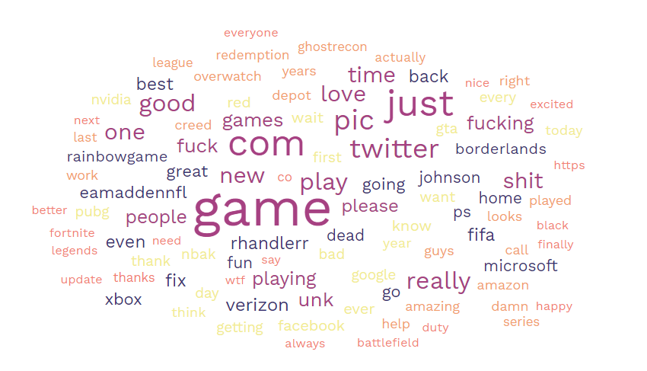
Word Cloud

Slide 6
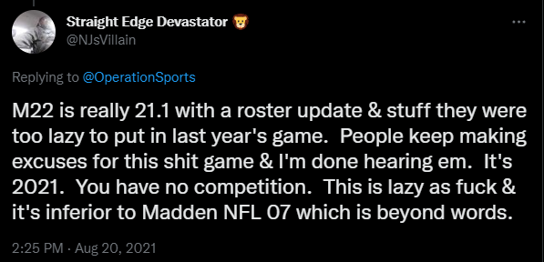
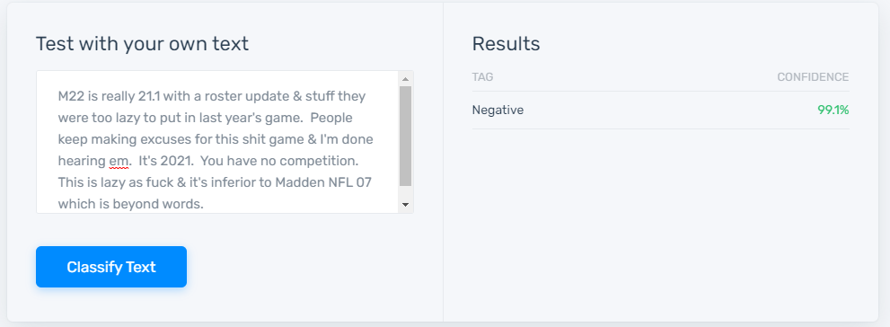
Sentiment Prediction
Sentiment analysis (also known as opinion mining or emotion AI) is the use of natural language processing, text analysis, computational linguistics, and biometrics to systematically identify, extract, quantify, and study affective states and subjective information. Sentiment analysis is widely applied to voice of the customer materials such as reviews and survey responses, online and social media, and healthcare materials for applications that range from marketing to customer service to clinical medicine.

Slide 7
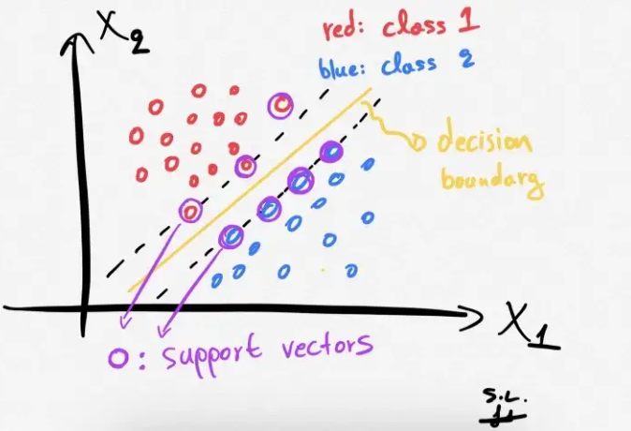
Machine Learning Algorithms Comparison
Multinomial Naïve Bayes
Support Vector Machine
Linear Kernel
Cross Validation [5 folds]
RBF Kernel
Polynomial Kernel

Slide 8

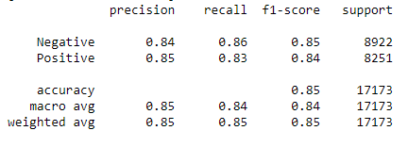
Multinomial Naïve Bayes
Overall model accuracy 85%.
Positive terms:
‘like’
‘good’
‘love’
Negative terms:
‘sh*t’
‘f*ck’
‘fix’
Confusion Matrix
Classification Report

Slide 9
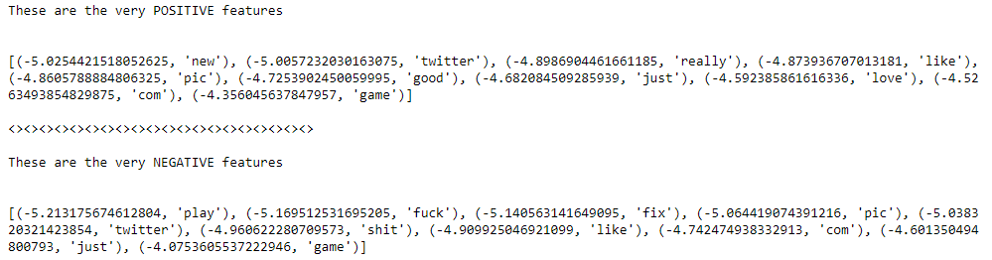
MNB Terms most likely to determine sentiment
We can leverage the Naïve Bayes Multinomial Classifier to determine which tokens are most likely to determine a positive or negative sentiment.
On the right portion of the slide are the terms that have the most polarization in determining if a tweet is either positive or negative.

Slide 10

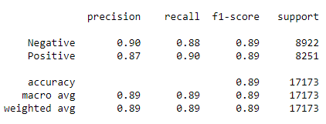
Support Vector Machine (Linear)
Overall model accuracy 89%.
Example of a “Negative” sentiment tweet that was mislabeled as “Positive” by the model:
Confusion Matrix
Classification Report
``` So while I was away I sold my PS4 Pro and Xbox One X to save on the new consoles, and I just love how I managed to pop a PS5 with Demons Souls and Miles Morales because Sony fucked me on the pre-order date, but I was happy to get an Xbox Series X because scalpers smh ```

Slide 11
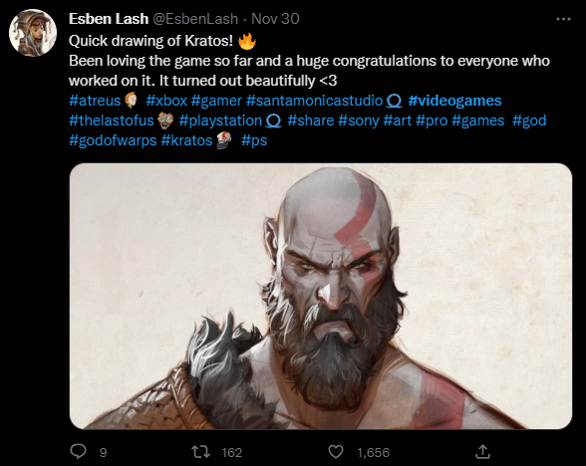
Conclusion
Machine Learning models can be utilized to determine the sentiment of a twitter posts.
The multinomial Naïve Bayes model performed great as well as the Support Vector Machine Linear Kernel. The SVM Linear Kernel had the best performance with over 89% accuracy.
Updates can be made to improve the model specifically with negation.
Positive!

Slide 12
Questions?

Slide 13
References
https://www.ubisoft.com/en-us/game/rainbow-six/siege
https://borderlands.com/en-US/welcome/
https://www.ea.com/games/madden-nfl/madden-nfl-22
http://www.columbia.edu/~ph2367/sentiment.html
https://towardsdatascience.com/support-vector-machines-svm-clearly-explained-a-python-tutorial-for-classification-problems-29c539f3ad8
https://twitter.com/hashtag/videogames

